Slide 1

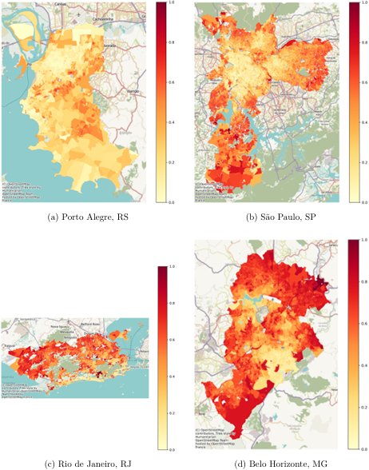
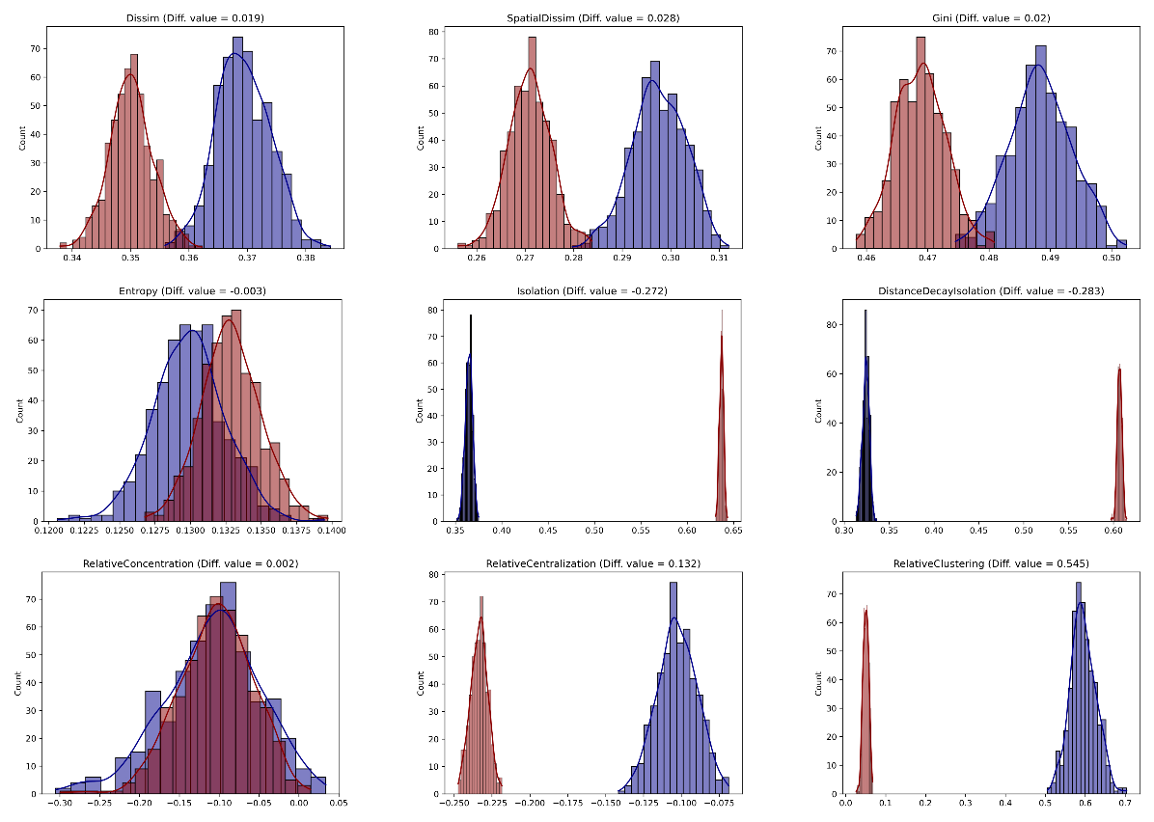
A Framework for Aspatial and Spatial Residential Segregation Measures: The PySAL segregation Module with Evidence from Brazil
Universidade Federal do Rio Grande do Sul – Instituto de Matemática e Estatística
Renan Xavier Cortes
renan.cortes@ufrgs.br
Introduction
Residential segregation is a multidimensional phenomenon that can be described through five main dimensions: evenness, isolation or exposure, clustering, concentration, and centralization.¹ Although numerous segregation measures have been developed to capture these dimensions, their practical application remains limited by methodological complexity, data requirements, and the lack of accessible computational tools. In addition, many empirical applications in Brazil have focused on a relatively narrow set of measures, particularly the Dissimilarity Index², potentially obscuring other dimensions of spatial inequality. Also, the literature on residential segregation emphasizes different dimensions across regions: income segregation in Brazil and Latin America, racial segregation in the United States, and ethnic segregation, particularly immigrant settlement patterns, in Europe.³
This work applies the PySAL segregation framework⁴ to the Brazilian racial context, combining multiple segregation measures with simulation-based statistical inference.
  Framework
  The PySAL segregation module provides an open-source framework for estimating and analyzing residential segregation in Python. It supports aspatial and spatial measures, including Dissimilarity, Gini, Entropy, Isolation, Relative Clustering, and Relative Concentration. The module integrates with pandas and GeoPandas and provides simulation-based inference using spatial permutation, bootstrap, and counterfactual composition to assess statistical significance and compare segregation across geographic contexts.
  Application
  The framework is applied to four major Brazilian metropolitan areas (São Paulo, Rio de Janeiro, Belo Horizonte, and Porto Alegre) using high-resolution census tract data from the 2022 Brazilian Census. The analysis focuses on the spatial distribution of the Black and Brown population and applies nine segregation measures covering multiple dimensions of segregation, including both aspatial and spatial formulations. This allows the study to move beyond a single-index perspective and investigate how different dimensions of racial residential segregation vary across Brazilian urban contexts.
A
Black + Brown composition of selected cities
Porto Alegre (blue) vs. Belo Horizonte (red) distributions
under bootstrap simulation
Preliminary Results
  The spatial distribution of the Black and Brown population reveals distinct racialized patterns across the four metropolitan areas. São Paulo and Belo Horizonte show a pronounced center periphery gradient, while Rio de Janeiro presents a more fragmented pattern, with high concentration areas close to affluent neighborhoods. Porto Alegre shows a weaker overall gradient but localized clusters in peripheral areas.
  The comparison between Porto Alegre and Belo Horizonte shows that segregation patterns depend on the dimension and measure considered. Porto Alegre presents higher Dissimilarity, Spatial Dissimilarity, Gini, and Relative Clustering, while Belo Horizonte shows higher Isolation and Distance Decay Isolation.
References
Massey, Douglas S, and Nancy A Denton. 1988. “The Dimensions of Residential Segregation.” Social Forces 67 (2). Oxford University Press: 281–315.
Sousa Filho, J. F., Pedeira, S. C., Santos, G. F., Guimarães, J. M. N., Ferreira, A. J. F., Alves, F. J. O., Nascimento, G. R., Paiva, A. S. S., Andrade, R. F. S., Góes, E. F., Barreto, M. L., & Aquino, E. M. L. (2023). Racial and economic segregation in Brazil: A nationwide analysis of socioeconomic and socio-spatial inequalities. Revista Brasileira de Estudos de População, 40, e0247. doi.org
BARROS, Joana; FEITOSA, Flavia da Fonseca. Ethno-racial segregation in São Paulo and London metropolitan regions: reflections on a comparative study. Revista Brasileira de Estudos de População, v. 41, e0262, 2024. DOI: http://dx.doi.org/10.20947/S0102-3098a0262
Cortes, R. X., Rey, S., Knaap, E., & Wolf, L. J. (2019). An Open-Source Framework for Non Spatial and Spatial Segregation Measures: The PySAL Segregation Module. Journal of Computational Social Science, 3(1), 135–166.

